Slide 1



Smart And Energy Efficient Room Automated System
Design And Fabrication Project (DS3001)
Mentor: Dr.Pushpa Raikwal Project ID: DFP_120

Slide 2







Meet our Team
S I D D H A N T R A I
2 0 B E C 1 03
R A H U L K U MA R
2 0 B E C 081
S U D H A N S H U N A R A Y A N
2 0 B E C 1 08
P R A S H A N T K U MA R S I N G H
2 0 B E C 07 4
R A C H I T G A R G
2 0 B E C 080
S . S A I P R I Y A N K A
2 0 B E C 097
S A U R A B H K U MA R J H A
2 0 B M E 054

Slide 3
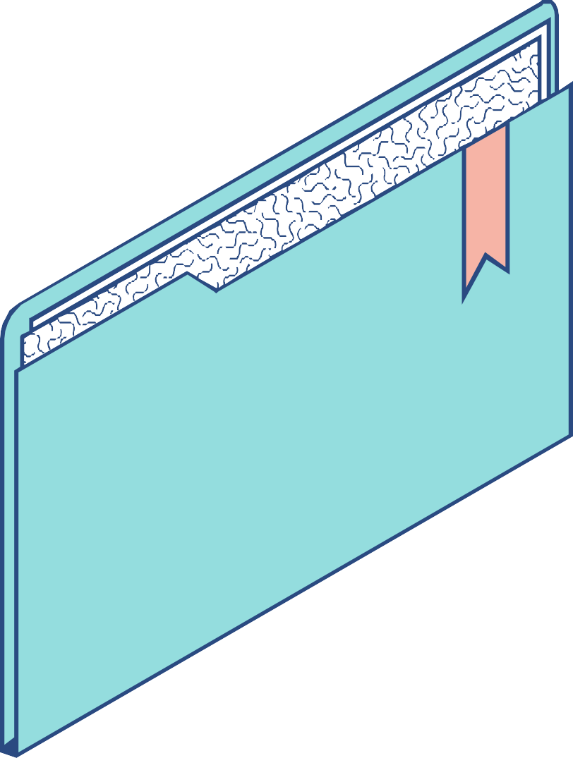
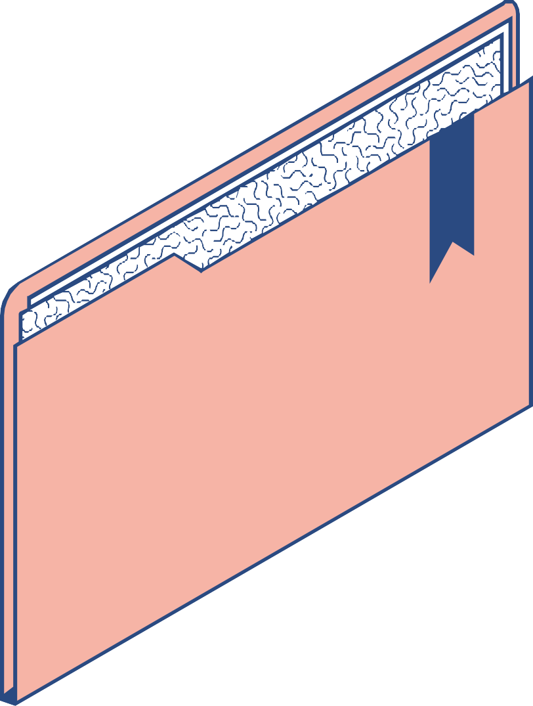
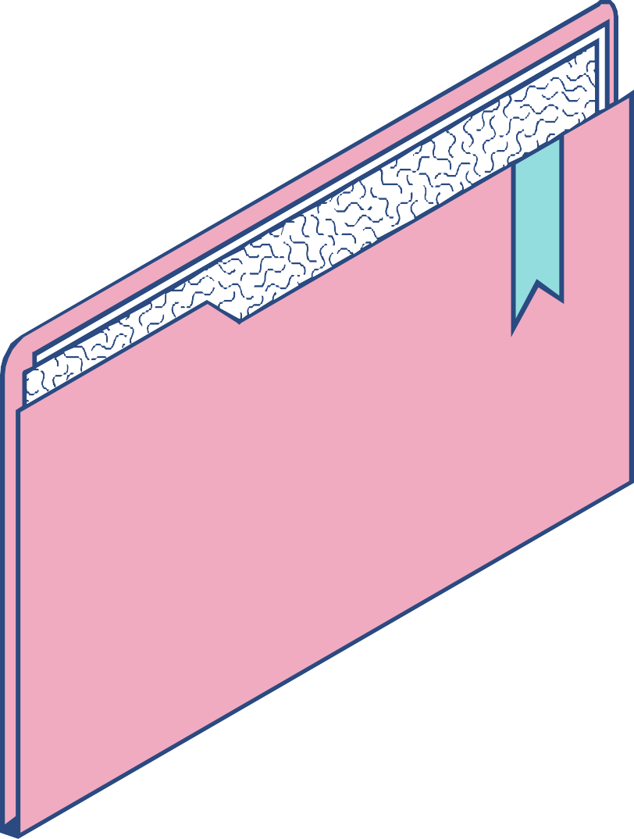
Index
KEY TOPICS DISCUSSED IN THIS PRESENTATION
Introduction Detailed Design Novelty Need And Identification Process Flow Functionality Camera View Circuit Website & App design CAD Design

Slide 4


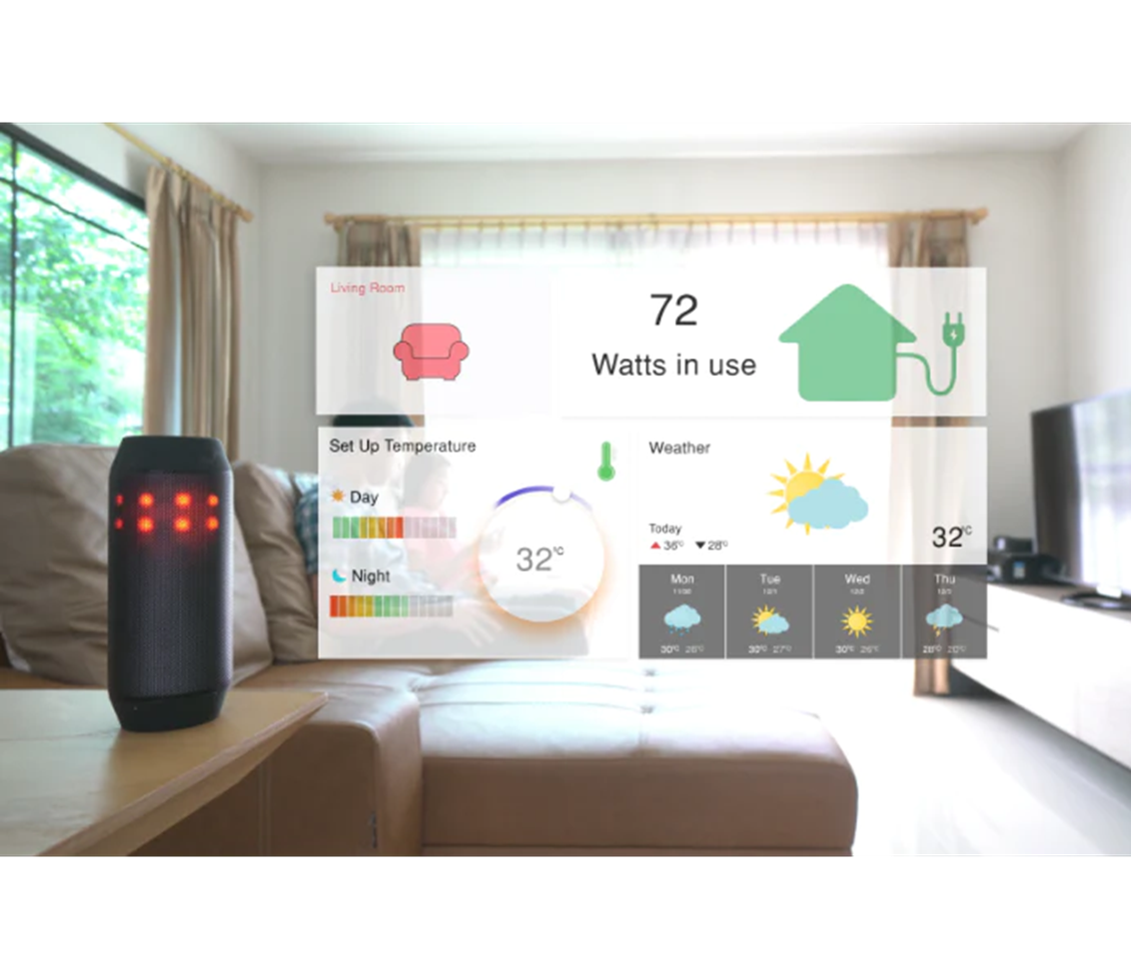
INTRODUCTION
One of the main concerns today is energy generation, consumption and preservation. Since the reserves of fossil fuels are limited, the use of alternative energy sources need to be encouraged.
Home Automation brings comfort and convenience to all areas of your home

Slide 5


Novelty(Completeness)
Previously built Voice Controlled Home Automation System has been helpful for handicapped people (reference) . Our project improves the home automation system that has a Central Control Unit(CCU) that controls all the appliances with voice automation.
We have a camera which is going to use Machine Learning and Artificial Intelligence to detect the presence of people in the room using a count value to turn off the central control unit(CCU).
Our home automation system not only focuses on automating the room appliances but also aims to save energy.

Slide 6

Need and Identification
Need Best method to save energy and to avoid accidents such as short circuit , firing etc.

Slide 7

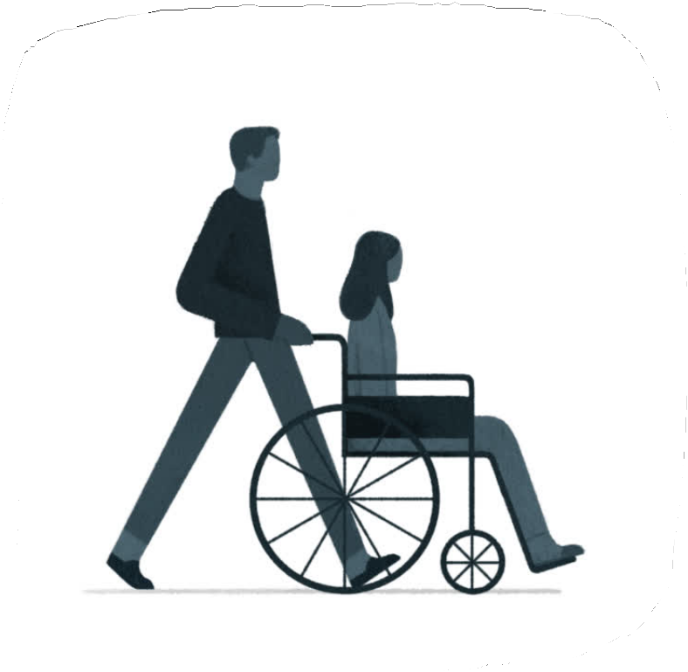
Need and Identification
Help for handicapped people so that they
don't need assistance for controlling electronic appliances.

Slide 8

PROCESS FLOW
Raspberry PI
Camera
NO
counter > 0
YES
Microphone
Room appliances off
ON/OFF
Other appliances
Fan
Light
Exit
counter=0

Slide 9
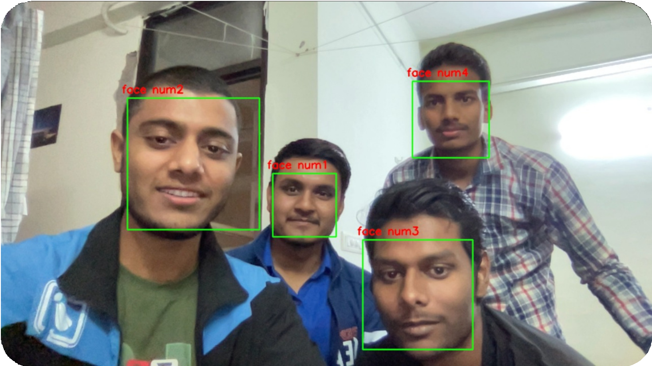
Functionality
CCTV Camera will be used to capture live feed of people entering/leaving the room.
AI model running on the Raspberry Pi will maintain the people count inside the room using live feed.

Slide 10

Functionality
If the down parameter is less than up parameter, the microphone becomes active which will be further used to control the room's appliances.
As soon as the up parameter is less than or equal to down parameter, the microphone becomes inactive and all the room’s appliances will be turned off automatically.

Slide 11
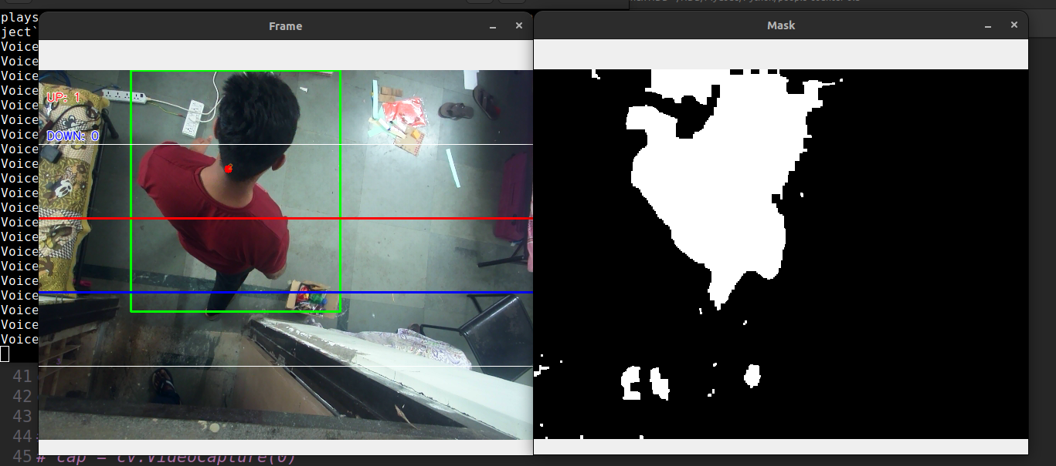
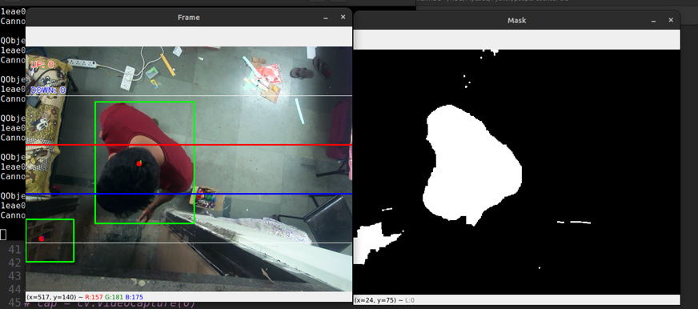
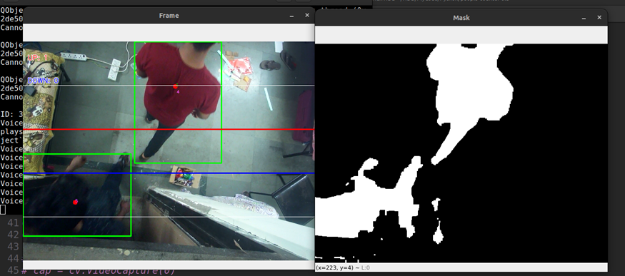
CAMERA VIEW

Slide 12
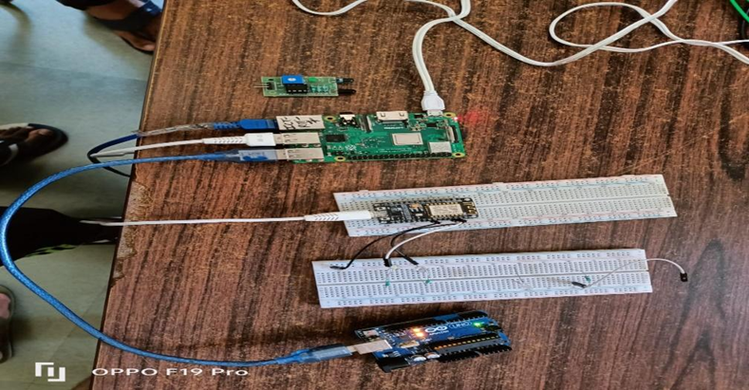
Node MCU

Slide 13
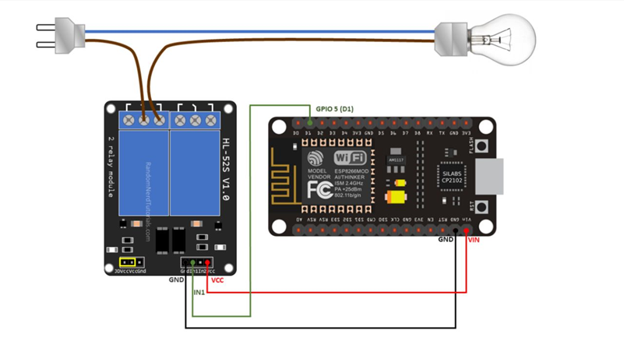
RELAY AND NODE MCU CONNECTION

Slide 14
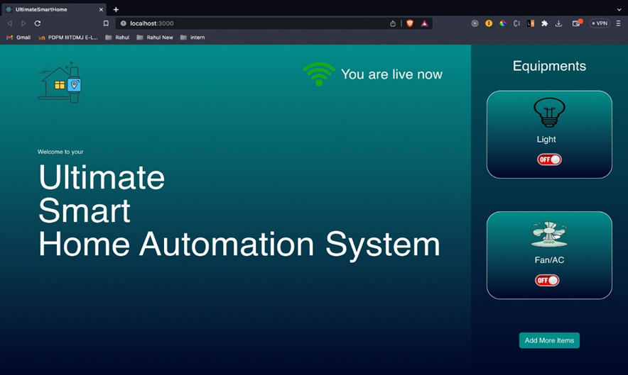
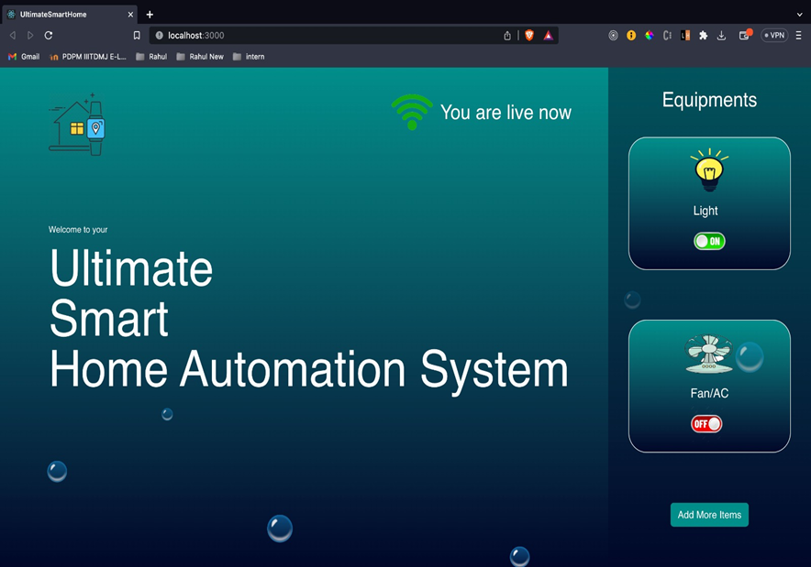
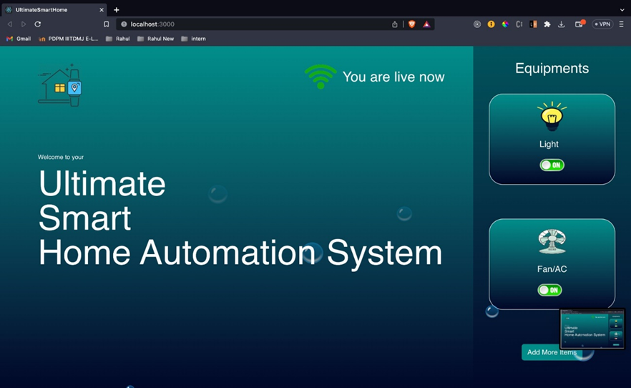
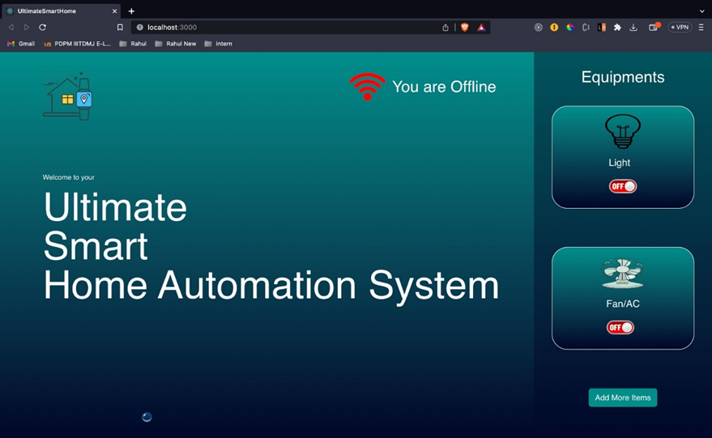
HOME AUTOMATION WEBSITE

Slide 15
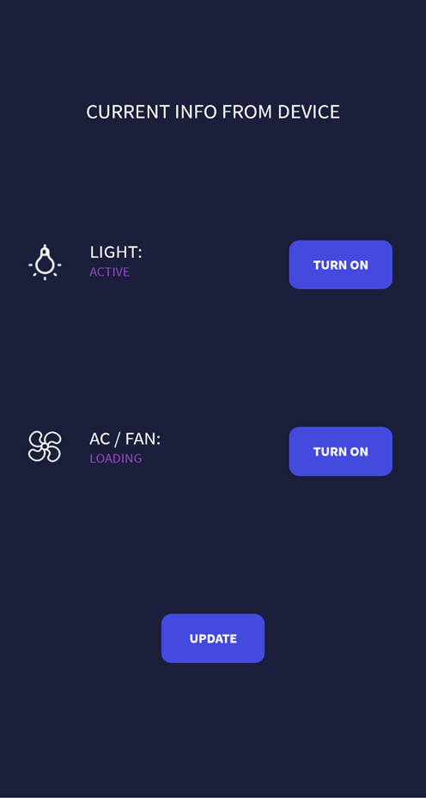
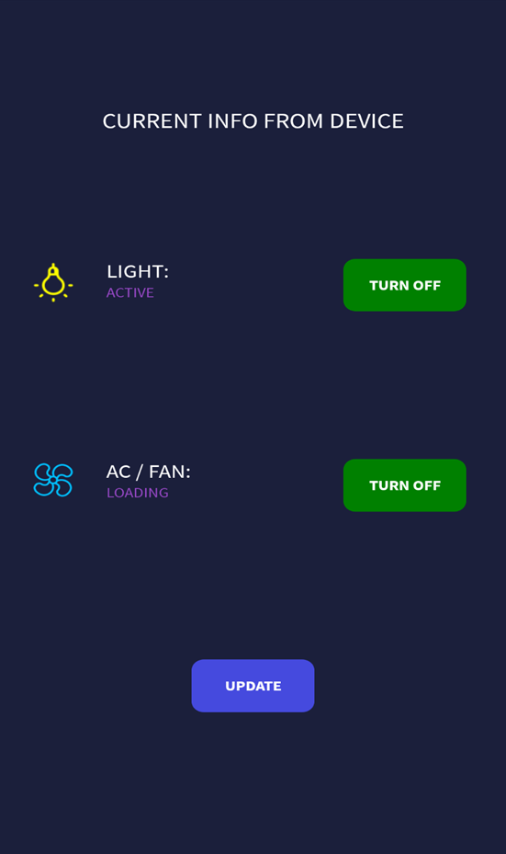
HOME AUTOMATION APPLICATION

Slide 16


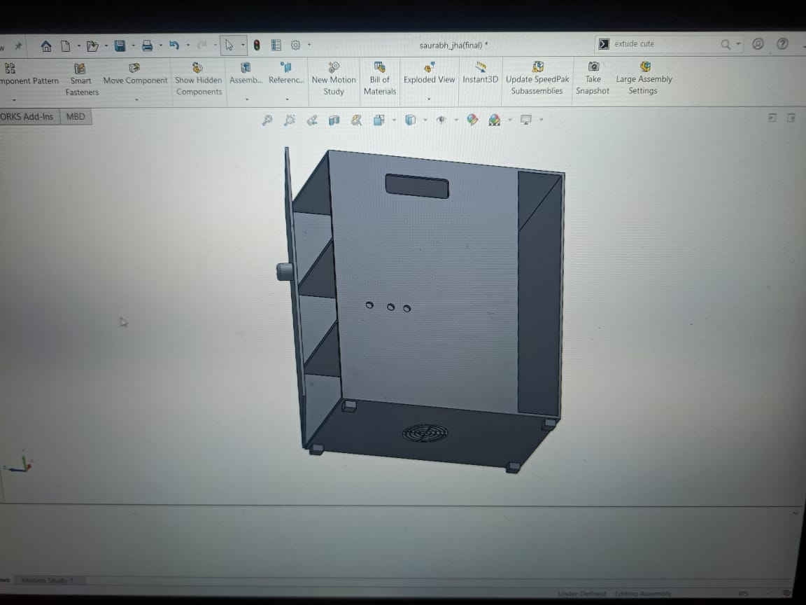
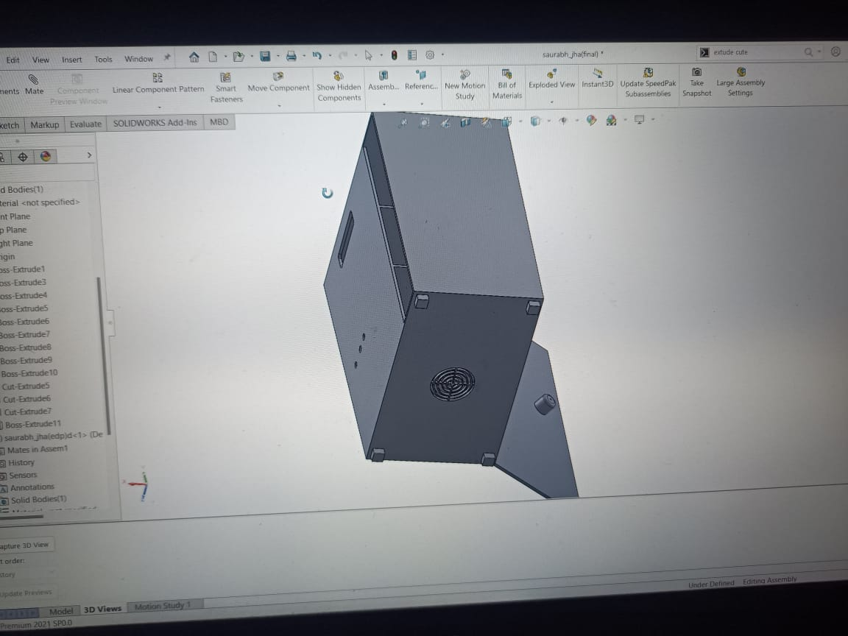



CAD Model

Slide 17
THANK YOU

